Slide 2
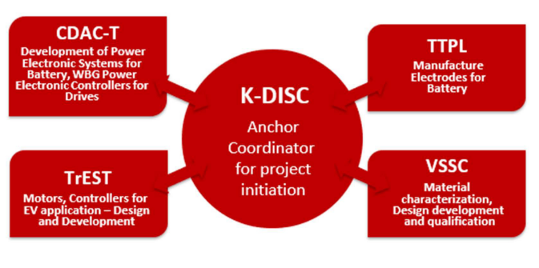
EV CONSORTIUM
K-DISC was appointed by the Government of Kerala as the nodal agency to spearhead the formulation and implementation of the Electric Vehicles Policy for the State and also suggest ways of bringing value addition to the mineral-rich beach sands of Kerala that can be utilized as a catalyst for change and bring about a manufacturing ecosystem in Kerala.
The Government of India plans to promote indigenous development and manufacturing of Electric Vehicles (EVs) and their components, under the National Mission for Tropical EV Technologies as well as the National Mission on Transformative Mobility & Battery Storage. The Government of Kerala has come up with its EV Policy with a vision “To embrace electric mobility as a tool to promote shared mobility and clean transportation and ensure environmental sustainability, pollution reduction, energy efficiency and conservation, and to create an ecosystem for manufacturing EV components in Kerala.” The Government of Kerala views the adoption of electric mobility as an opportunity for the promotion of a related manufacturing ecosystem in the state. This gives an opportunity for developing associated technologies utilizing the mineral wealth available in the sands of Kerala.

Slide 3
K-DISC
Kerala Development and Innovation Strategic Council (K-DISC) is the strategic think-tank advisory body of the Government of Kerala, formulating plans reflecting the latest in technology, product and process innovations for the development of the State. It seeks to address the challenges of providing holistic health care, employment, social security, infrastructure, food and nutrition security with a pro-poor bias, gender justice and inclusion of outliers, within severe fiscal constraints.
VISION:
A competitive and inclusive Kerala through the creation of a healthy, conducive ecosystem for transformative and bold innovations through new directions in technology, product, and process innovations.

Slide 4
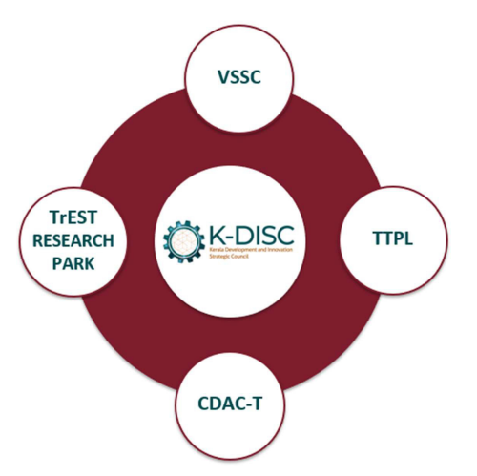
Role of K-DISC in EV Consortium
K-DISC
Mission:
1.Holistic And Quality Human Development In Kerala.
Fostering innovation by elevating participants’ creative thinking.
Promoting collaborative, human-centered, real-life, multifaceted-interdisciplinary problem-solving in a framework of design-thinking, bricolage, and maker spaces.
Promoting core values of practice of STEM like scientific temper, searching for uncertainty, recognizing ambiguity, and learning from failures through past and present learning.
Developing programmes for the workforce to improve their employability and adapt to new forms of work.
Role of K-DISC in EV Consortium
Anchor coordinator of the EV Consortium project.
To support and coordinate the Partners in developing the EV Manufacturing ecosystem in Kerala.
To bring in suitable Private players and Government institutions in the Consortium whenever required.

Slide 5
Role of K-DISC in EV Consortium
K-DISC
Role of K-DISC in EV Consortium
2. A Knowledge-Centered Technology Based Local
Economy With Global Connect
A modern and competitive tech-savvy workforce with capabilities in handling complex problems.
Innovative, resilient, and environment–friendly development infrastructure for rapid growth.
Modern governance system capable of handling second-generation development issues.
3. Enhanced Inclusion, Participation, And Self-
Reliance Through Cutting-Edge Knowledge And
Technology.
Enhanced capacities of the marginalised in the current economic environment through protective processes, institutional systems, technology, and multi-stakeholder platforms.
4. Seeding New Knowledge-Based Industries
Through Coordinated Projects With The
Participation Of Multiple Stakeholders.
To conduct periodic reviews ensuring the progress of the developmental activities of the Consortium.
To create policy frameworks and procedures.
To provide funding to the partners and other players engaging with the Consortium.

Slide 6
TTPL
Travancore Titanium Products Limited (TTPL) is the leading manufacturer of Anatase Grade Titanium Dioxide in India. The Company was incorporated in 1946 at Thiruvananthapuram, promoted by then Maharaja of Travancore, His Highness Chithira Thirunal Balarama Varma, with the technical Advice of British Titan Products (now Huntsman Trioxide). The company was taken over by the State Government of Kerala in 1960. The main product is Titanium dioxide which is extracted from ilmenite, which is abundantly available as placer deposits on beaches of Kollam. TTPL employs Sulphate Route technology for producing both Anatase and uncoated Rutile Titanium dioxide
.

Slide 7
Role of TTPL in EV Consortium
TTPL
To supply LTO/LFP materials for electrode manufacturing, as the main product from TTPL is Titanium dioxide which is extracted from ilmenite, abundantly available in the beach sands of Kerala. Also, TTPL can be involved in supplying materials for manufacturing cells of varying chemistry.
Lithium titanate (LTO) or Lithium Ferrous Phosphate (LFP) can be used as anode of a standard lithium-ion battery, where as, Lithium Manganese Oxide (LMO) or Lithium Nickel Manganese Cobalt Oxide (NMC) as the cathode.
Advantages of LTO:
LTO carries certain advantages over the conventional Li-ion with graphite anode, including the absence of Solid Electrolyte Interphase (SEI) film formation and lithium plating when fast charging and charging at low temperature.
LTO’s Thermal stability under high temperature is superior to other Li-ion systems.
LTO powder prevents the occurrence of aluminum alloying, which in turn enables the aluminum current collector to generate a significantly enhanced gravimetric capacity compared to copper…
VISION
Working together to meet the ever-growing needs of our customers from various industries, globally.
MISSION
Produce the best product inspiringly and no harm to the environment.

Slide 8
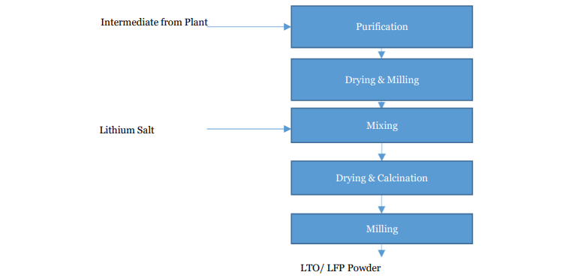
Manufacturing Process of LTO/LFP Powder
TTPL
Sulphate Route Technology
The main product is Titanium dioxide which is extracted from ilmenite, which is abundantly available as placer deposits on beaches of Kollam. TTPL employs Sulphate Route technology for producing both Anatase and uncoated Rutile Titanium dioxide.

Slide 9
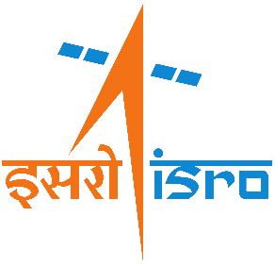
Vikram Sarabhai Space Centre (VSSC)
The lead Centre of Indian Space Research Organization (ISRO) under the Department of Space (DOS), Government of India. The Centre is named in fond memory of Dr Vikram A Sarabhai, the great visionary and the father of Indian Space Programme.
VSSC pioneers in rocket research and launch vehicle projects of ISRO. The Centre also pursues research and development activities in associated areas like propellants, solid propulsion technology, aerodynamics, aero structural and aero thermal fields, avionics, polymers and composites, guidance, control & simulation, computer and information, mechanical engineering, aerospace mechanisms, vehicle integration and testing, space ordnance, chemicals and materials. Systems reliability and quality assurance of all aspects of engineering and operations are studied and evaluated to the levels of perfection required in each field.

Slide 10
Vikram Sarabhai Space Centre (VSSC)
Role of VSSC in EV Consortium:
Cell Manufacturing is a multi-stage process that depends on cutting-edge battery technologies and clean-room environments to ensure the successful assembly of a complete battery pack. Rolls of electrodes must first be cut (i.e., slit) into smaller sheets. Initial battery assembly involves the construction of a single cell which is composed of multiple layers of anodes, electrodes, and separators that are immersed in an electrolyte and sealed in a plastic package.
R&D activities including, material characterization of electrode materials, cell assembling, performance evaluation, and battery development.
Material characterization including physical and electrochemical characterization of LTO/LFP anode materials obtained from TTPL.
Using these anode materials and NMC as cathode, smaller capacity, medium capacity, and large capacity cells are assembled and performance is evaluated.
Performance evaluation in the sense, that each cell is subjected to several quality control measures which involve repeated charging and discharging, environmental simulations (i.e., Aging Process), degassing, and testing.
It is estimated that between two to five percent of cells would fail some component of the testing. Once a cell successfully passes these tests, it is ready for placement in a battery module.
A battery module is constructed by layering several cells in a metal casing. Finally, multiple modules are combined along with other required components to form a complete battery pack.
Vision:
Harness, sustain and augment space technology for national development, while pursuing space science research and planetary exploration.
Mission:
Design and development of launch vehicles and related technologies for providing access to space.
Design and development of satellites and related technologies for earth observation, communication, navigation, meteorology and space science.
Communication programme for meeting telecommunication, television broadcasting and developmental applications.
Satellite-based Remote Sensing programme for management of natural resources and monitoring of environment using space based imagery.
Space based Applications for Societal development.
Research and Development in space science and planetary exploration.
Promote and authorise private firms to play key role in global Space market.

Slide 11
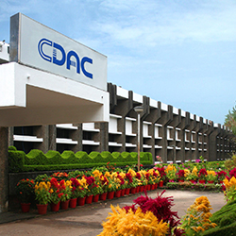
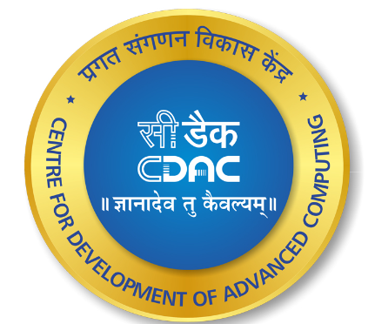
Centre for Development of
Advanced Computing (C-DAC)
Centre for Development of Advanced Computing (C-DAC) is the premier R&D organization of the Ministry of Electronics and Information Technology (MeitY) for carrying out R&D in IT, Electronics and associated areas. Different areas of C-DAC, had originated at different times, many of which came out as a result of identification of opportunities.
C-DAC has today emerged as a premier R&D organization in IT&E (Information Technologies and Electronics) in the country working on strengthening national technological capabilities in the context of global developments in the field and responding to change in the market need in selected foundation areas. In that process, C-DAC represents a unique facet working in close junction with MeitY to realize nation’s policy and pragmatic interventions and initiatives in Information Technology.

Slide 12
Centre for Development of
Advanced Computing (C-DAC)
Role of C-DAC in EV Consortium:
The battery modules are a combination of individually matched cells arranged in a series-parallel fashion to achieve voltage and current ratings. Because of production tolerances, individual cells may differ in characteristics. A Battery Management System (BMS) monitors the battery operation and protects it both at the module level as well as down to the microcell level. BMS also addresses various other aspects related to battery such as ensuring optimum power delivery and prolonging the life of the battery. Communication and interfaces to the other application-specific modules are also part of the BMS.
Recent advancements in Wide Band Gap (WBG) based Power Electronics converters offer better efficiency and lesser size allocation for automobile applications. Silicon Carbide (SiC) semiconductor devices are targeted for medium voltage power electronic applications with high-frequency switching. Similarly, for low voltage power electronic applications with high-frequency switching, Gallium Nitride (GaN) based devices are preferred. An integration of an electric motor and a drive with wide-bandgap devices will help to achieve compact and lightweight motor-inverter combinations. Volume and weight are especially important factors for motor systems designed for automobiles.
Roles of C-DAC include:
Design and development of a Battery Management System (BMS) for LTO cells. The indigenous design of BMS is based on the cells designed by TTPL-VSSC.
Type testing of the hardware modules, thermal design, mechanical enclosure design, and endurance testing of BMS.
Design and development of a Wide Band Gap (WBG) Power Electronic Controller for drives.
VISION:
To emerge as the premier R&D institution for the design, development and deployment of world class electronic and IT solutions for economic and human advancement.
MISSION
Expand the frontiers of Electronics and Information Technology.
Evolve technology solutions - architectures, systems and standards for nationally important problems.
Achieve rapid and effective spread of knowledge by overcoming language barriers through application of technologies.
Share experience and know-how to help build advanced competence in the areas of Electronics and Information Technology.
Bring benefits of Electronics and Information Technology to society.
Utilize the Intellectual Property generated by converting it to business opportunity.

Slide 13
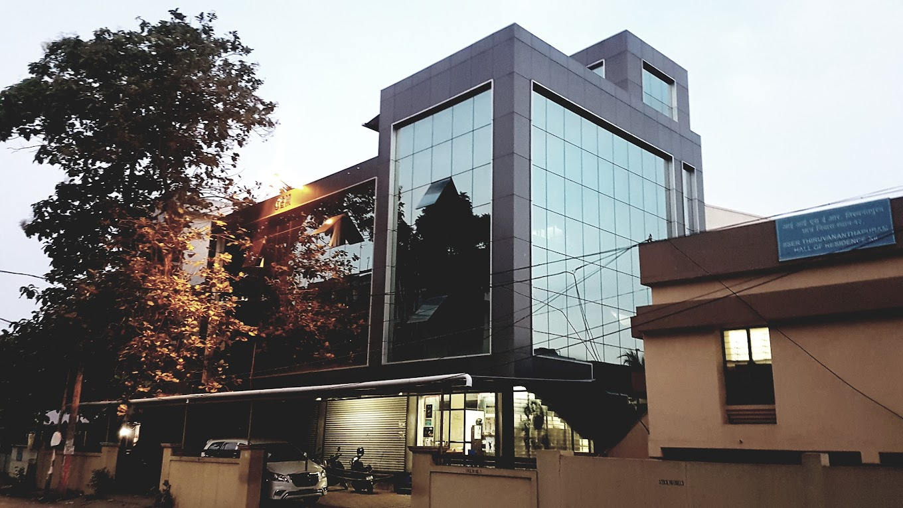
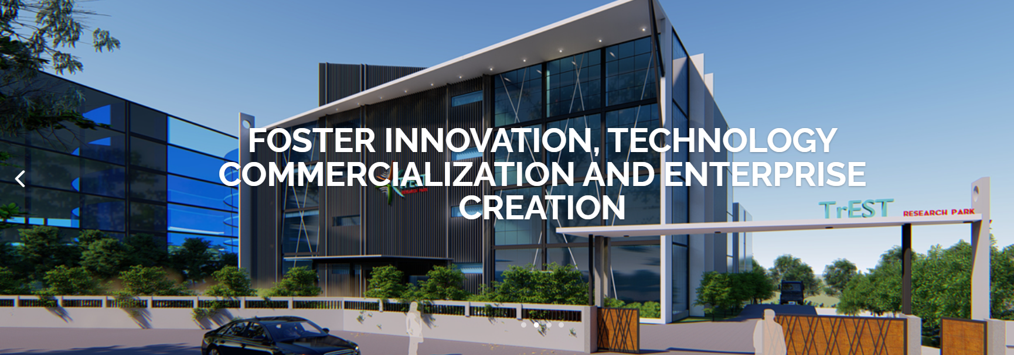
TREST RESEARCH PARK
The main objective of Trivandrum Engineering Science and Technology (TrEST) Research Park is to promote partnership and interaction between academic community and industry. The synergy is expected to benefit both and bring about qualitative and quantitative improvements. The model is seen as the vehicle for growth in the knowledge economy and has already been proved in Stanford Research Park in Silicon Valley, IIT Madras Research Park in Chennai and many more in China and other countries.
It is expected that TrEST Research Park will succeed in developing new technologies and fostering inventions resulting in new technology companies coming up in the Park in various engineering disciplines. The vision of the Park is to eventually bring in all engineering and technology academic and research institutions in Kerala into its fold. From the State’s perspective, TrEST Park will help in generating high quality employment and help in the economic development of the State.

Slide 14
TREST RESEARCH PARK
To set up a Drive Train Lab, in order to facilitate the development testing of Drive Train Systems.
The design, development, and testing of Drive Train Systems, along with the support of the Industry Partner.
Promote Research in powertrain for indigenous technology development.
Provide testing facility for EV Technologies in a phased manner:
Phase 1 - Powertrain Technology-Low Voltage, Low power systems for two and three-wheelers.
Phase 2 – Powertrain Technology-High Voltage, High power systems for cars, busses, and other commercial vehicles.
Phase 3 - Environmental testing facilities for powertrains.
Phase 4 - Testing facilities for battery manufacturing and charger manufacturing companies
Finalisation of specifications of motor controller and development of 4.5 KW & 120 KW Traction Motors.
Development of IGBT/MOSFET-based controllers.
Testing of Prototype (Motor & Controller) for suitability for EV.
Design optimization of Motor & Controller.
Development of Production-grade Motors and controllers to be manufactured and commercialized.
The major focus areas of TrEST Research Park are in the areas of Electric Vehicle and Microprocessor Design. From the State’s perspective, TrEST Park will help in generating high quality employment and facilitate economic development.
The Electric Vehicle Centre of Excellence in TrEST Research is envisaged to be a multidisciplinary centre with collective approach to understanding the impact of electrification on the future of mobility and the future of the industry.
The EV CoE addresses this complex challenge by conducting fundamental research, working with industry and other stakeholders and also provide testing and qualification.

